Slide 1
THEORETICAL AUTONOMOUS SATELLITE COLLISION AVOIDANCE (TASCA)

Slide 2
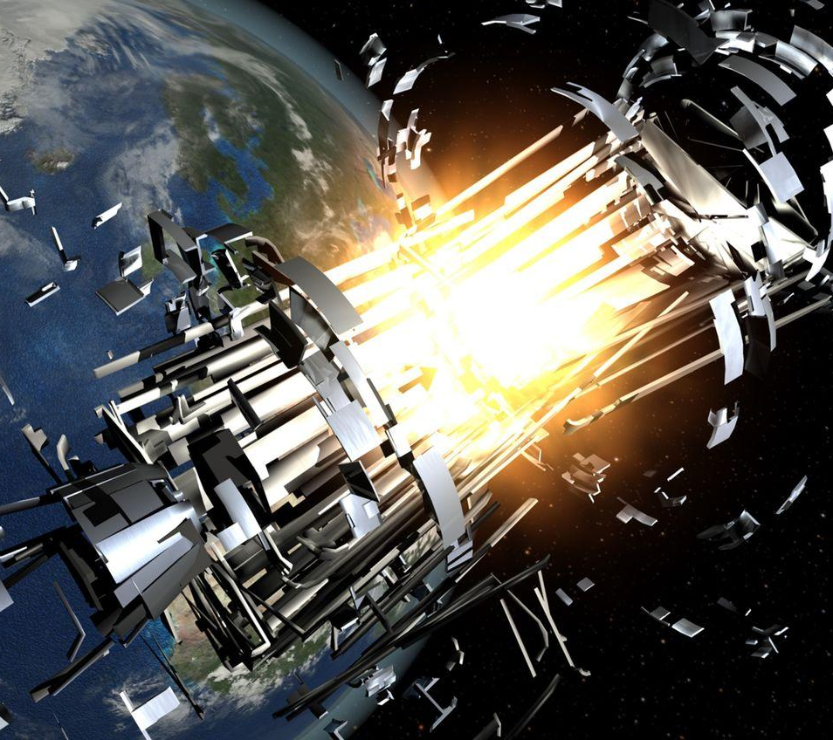
Problem & Motivation
Growing number of satellites and debris increase the risk of collisions
Avoiding collisions saves expensive hardware and debris cascades
One collision = many fragments

Slide 3
Approach: Representing Motion
Clohessy-Wiltshire relative dynamics
A compact rule that predicts how a small object moves relative to a nearby reference object
Captures main forces and gives a six-number snapshot (position and velocity) of relative motion

Slide 4
Approach: Simulating Future Motion
RK4 propagation
A numerical stepper that takes the snapshot and advances it forward in short time steps
Each step uses local slope information so the simulated path is smooth and accurate for short horizons

Slide 5
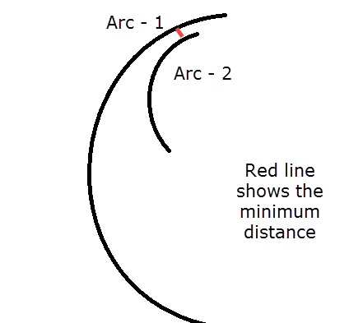
Approach: Judging Danger
Closest-approach metric
Compute the smallest distances between the two simulated paths over the look-ahead window
Minimum distance is the collision risk score
Small scores = high risk

Slide 6
The Oracle
Simulate encounter
Simulates the encounter
Finds the time of closest approach
Computes a short, direct velocity change (Δv) to make minimum distance safely larger
Output is this small nudge and when to apply it
Find closest time
Compute small∆v and time to apply

Slide 7
Forming a Dataset
The oracle gives correct answers for individual counters
However, we want a function that can propose nudges quickly
Thus, we generate thousands of varied encounters to form input-output examples

Slide 8
Dataset Structure
Observable State
x
Each example pairs the current observable state (positions and velocities) with the oracle’s recommended nudge
That pairing is the supervised training signal
Oracle ∆v
y
∆vx
z
∆vy
vx
∆vz
vy
vz
Supervised learning pairs state with action.

Slide 9
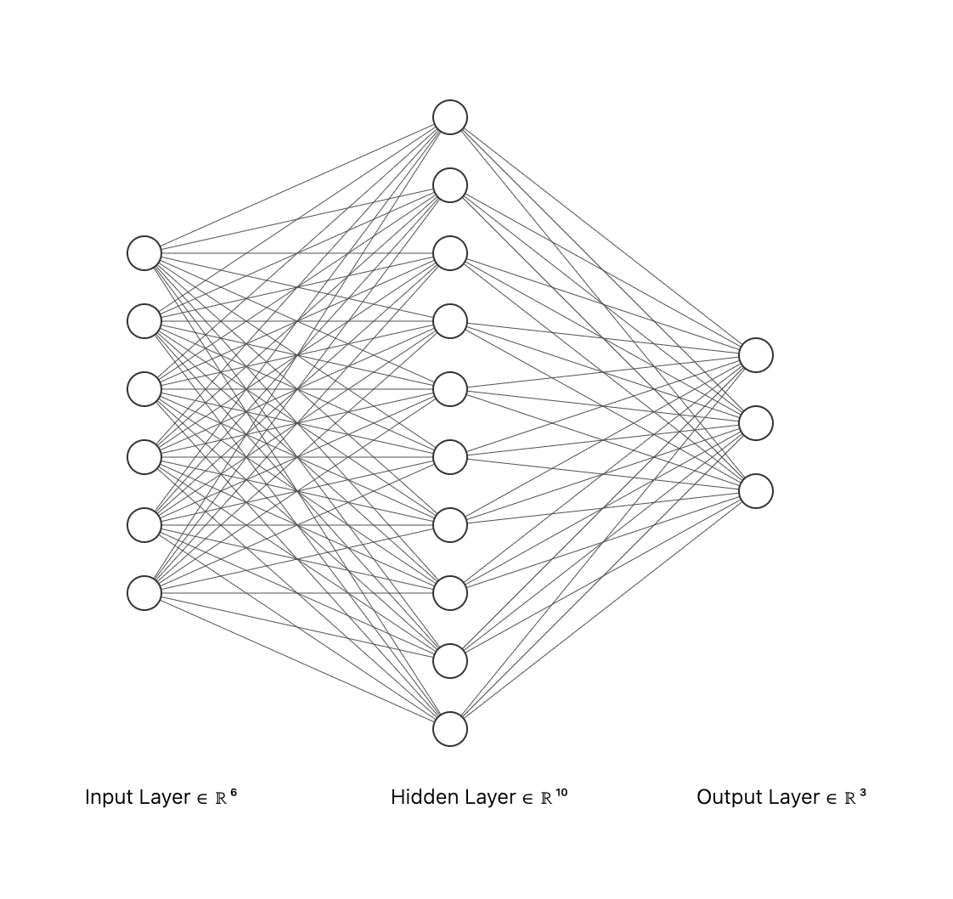
Learned Model
A compact mathematical function implemented as a small, feedforward neural network
Takes same six inputs and outputs a three-number velocity suggestion

Slide 10
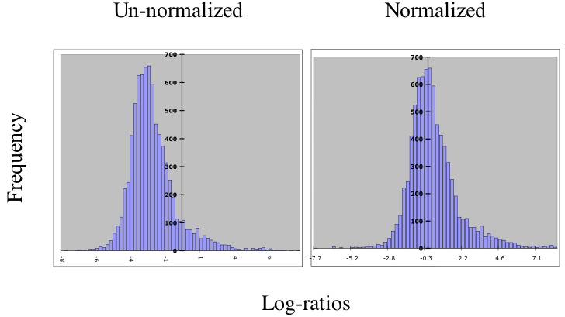
Normalizing Inputs
We scale each input so the network learns faster and generalizes better
At prediction time we apply the same scaling and then undo it on the output

Slide 11
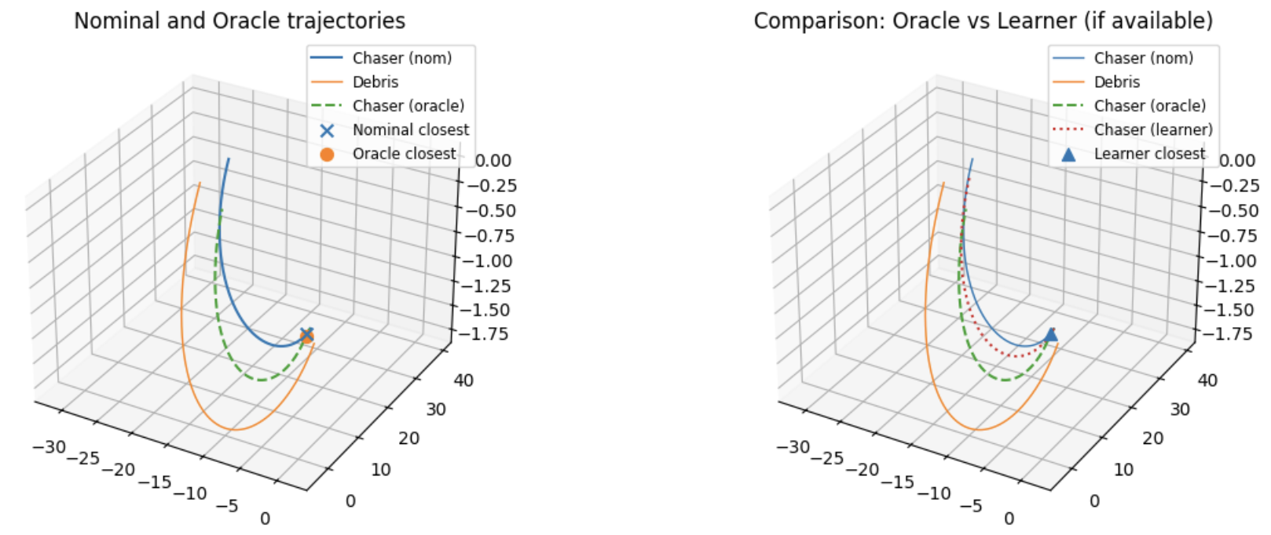
Determining Success
Given the three trajectories: original (no action), oracle (teacher action), and learner (network action), we compare the minimum distances and the amount of velocity used.

